Slide 1

Telco Customer Churn Prediction
DATA 606 Capstone in Data Science
Team Members
Harshini Akkapally - RK84133
Sravani Ravulaparthi - PN88693
Akhila Amaranayani - UD82090
Under the guidance of Professor
Dr. Ozgur Ozturk

Slide 2


Introduction
Customer Churn/Attrition occurs when consumers stop using a service or quit a company
Retaining customers is important for any business to boost revenue
Cost of acquiring a new customer is five times more than that of retaining an existing customer
Machine learning offers efficient ways to identify the root causes of churn as well as prescriptive tools for addressing it
We Identify behavioral patterns of customers who have already stopped using the services
Compare the behavior of the current consumers to these patterns to find potential churners

Slide 3

Dataset
Open-source IBM Dataset used in telecommunications sector to track customer turnover
It was initially published in the IBM Community and now available on Kaggle website
source: https://www.kaggle.com/datasets/blastchar/telco-customer-churn
The dataset contains 7,043 customers and 21 variables
It includes data on each customer’s demography, the environments of internet connection and related support, contract terms, billing and payment methods, and the amount charged

Slide 4

The data set includes information about:
Target Variable – ‘Churn’, Customers who left within the last month
Other Variables include,
Services that each customer has signed up for – phone, multiple lines, internet, online security, online backup, device protection, tech support, and streaming TV and movies
Customer account information – how long they’ve been a customer, contract, payment method, paperless billing, monthly charges, and total charges
Demographic info about customers – gender, age range, and if they have partners and dependents
Variables In Dataset

Slide 5
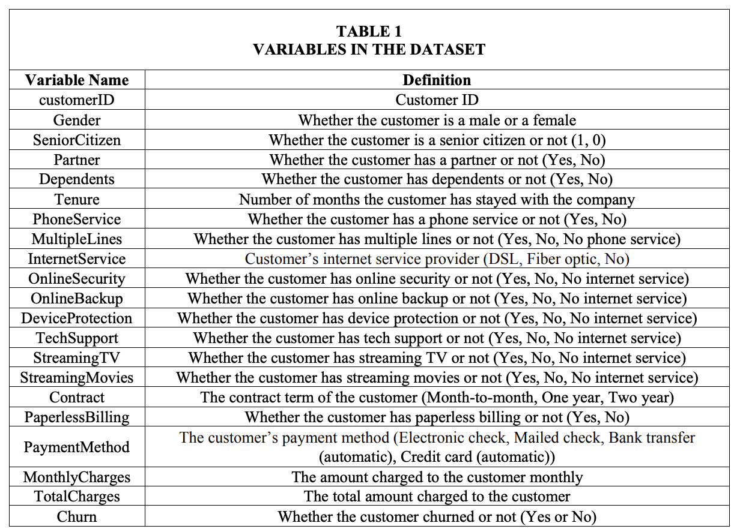

Slide 6
Literature Review
Most popularly used algorithms in prior studies from 2002 to 2013 were traditional ones such as Logistic Regression, Decision Tree, and Artificial Neural Network
Eria and Marikannan (2018) reviewed more recent articles published from 2014 to 2017. Their review showed that traditional machine learning algorithms were still dominant in this period
Most frequently used classification algorithms in this period were SVM (Support Vector Machine) and Neural Network, followed by Decision Tree, Naïve Bayes, and Logistic Regression
In the analysis of Lee et al. (2017), Neural Network achieved the highest accuracy, followed by Decision Tree and Logistic Regression
Bharadwaj et al. (2018) showed that Neural Network achieved higher accuracy than Logistic Regression

Slide 7
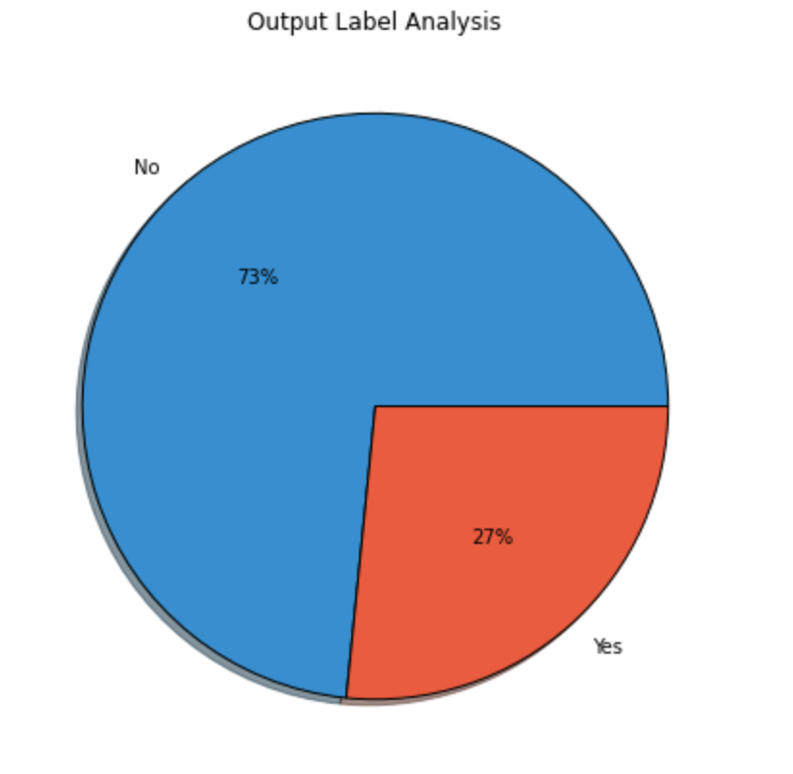
Data Analysis by Churn
The pie chart shows that the dataset is slightly imbalanced.
27% of the data belongs to churn class
73% of the data belongs to the customers who didn’t churn

Slide 8
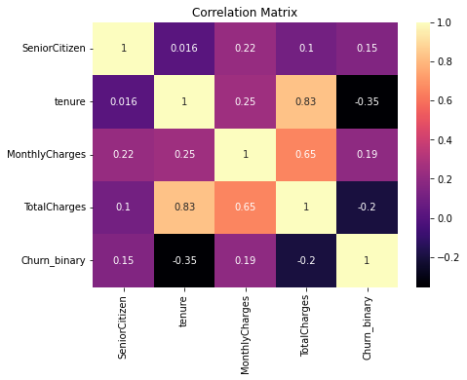
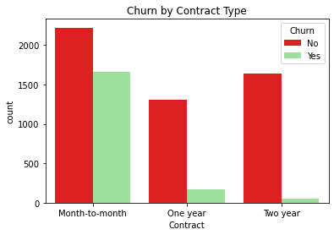
Correlation Analysis
Churn by Contract Type
This plot shows the number of customers in each contract type for each value of the 'Churn' column.
We can see that customers on month-to-month contracts are more likely to churn than those on longer-term contracts.
There is a multi-collinearity present between total charges and tenure
It means with increase in tenure the customers tend to charged more

Slide 9
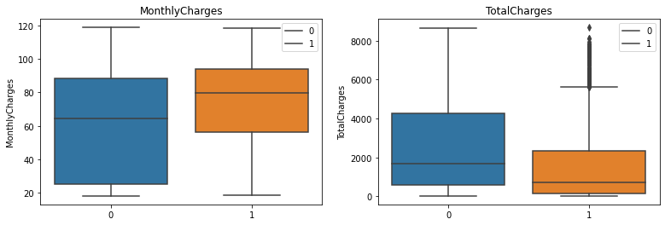
Box Plot Analysis Of Monthly, And Total Charges
This plot shows the distribution of monthly charges for customers who churned and those who did not
We can see that customers who churned tend to have higher monthly charges, and have low total charges

Slide 10
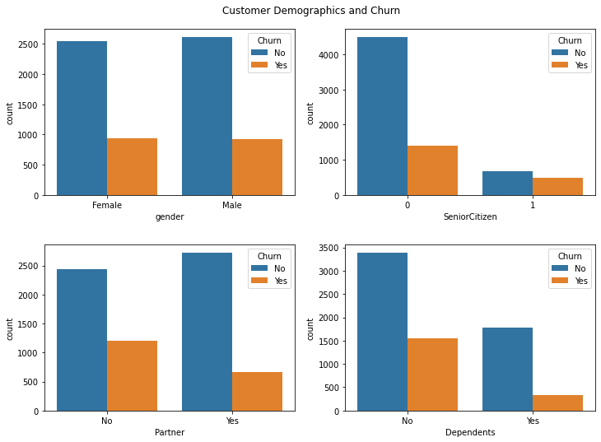
Churn By Customer Demographics
The senior citizen and gender doesn't have a strong relationship with churn column
Customer's having no Partner, or no Dependent are highly likely to churn as compared to those have partners or dependents

Slide 11
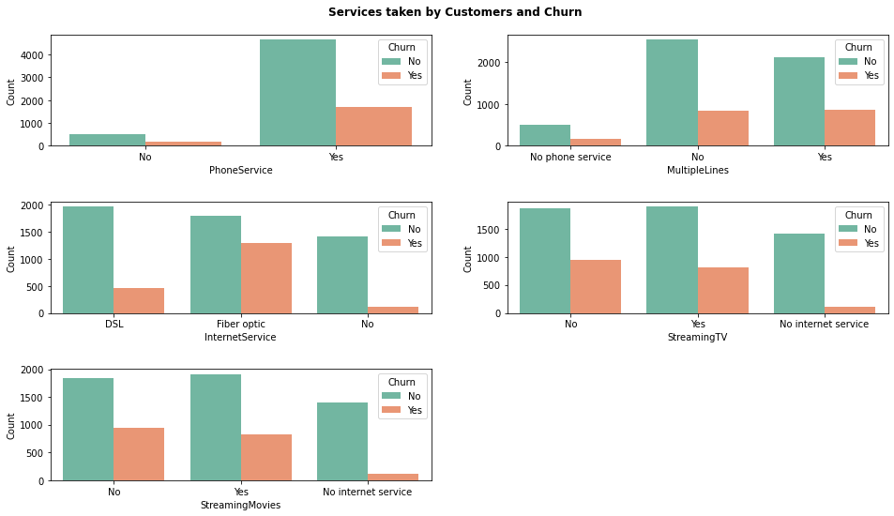
Churn by Services Taken
Those customers who have taken Fiber Optics as the internet service are most likely to churn
Customer's having streaming and TV services has high customer churn as compared to those doesn't have any internet services

Slide 12
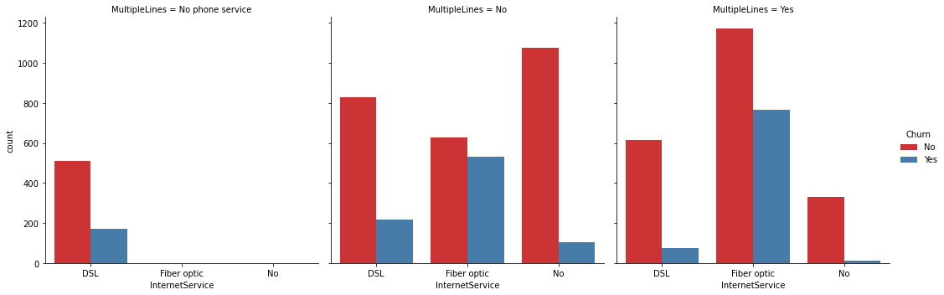
Churn By Internet Service and Lines
Customers having Fibre optics and multiple line are high likely to churn

Slide 13
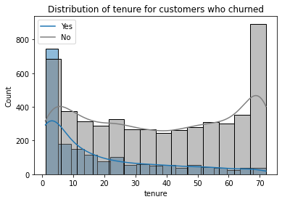
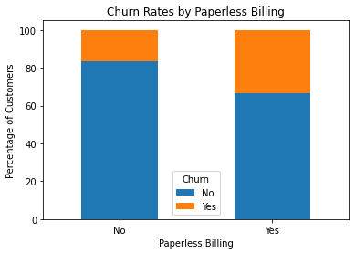
Churn Analysis Based On Tenure Of Service
Churn Analysis Based On Payment Method And Billing
We can see that the customers who churned tend to have lower tenures compared to those who didn't churn
Customers who use paperless billing are slightly more likely to churn

Slide 14
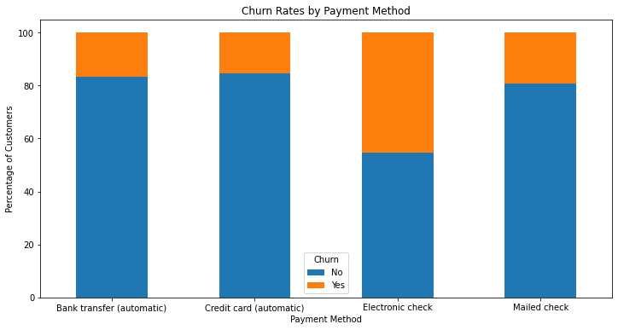
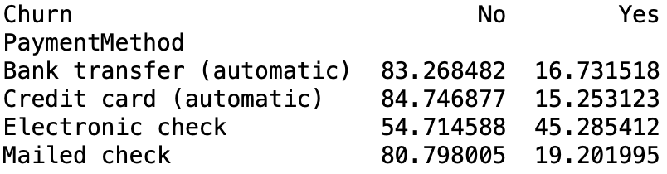
Churn Rates by Payment Method
Customers who pay by electronic check are more likely to churn than those who pay by other methods

Slide 15
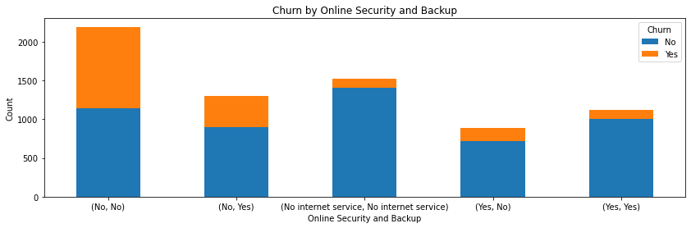
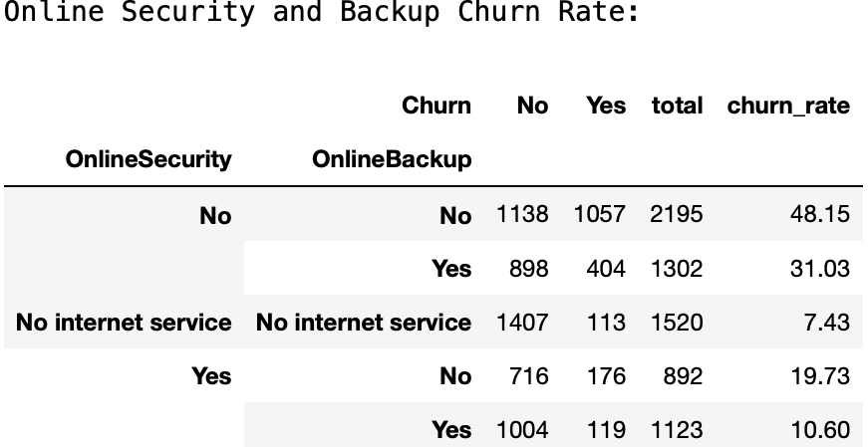
Churn Analysis Based On Online Security And Backup
Customers who do not have online security or backup are more likely to churn than those who have these services.
Additionally, customers who have online security and backup are less likely to churn than those who have only one of these services or none at all.

Slide 16
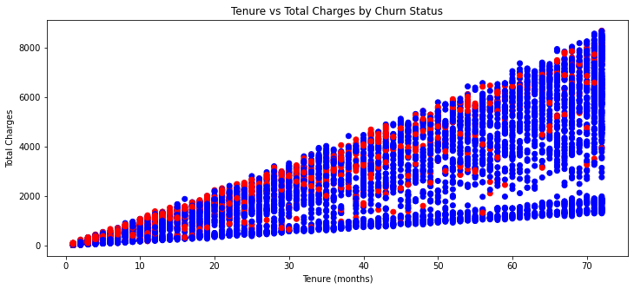
Tenure vs Total Charges by Churn Status
The customer churn rate is decreasing with increase in tenure and total charges. Most of the customers are retained with increase in tenure.

Slide 17
MACHINE LEARNING MODELS
Supervised Models
Logistic Regression
Random Forest Classifier
Decision Tree Classifier
K-Nearest Neighbor
Gaussian Naive Bayes
Multinomial Naive Bayes
Ada Boost Classifier
Gradient Boost Classifier
XG Boost
80
20

Slide 18
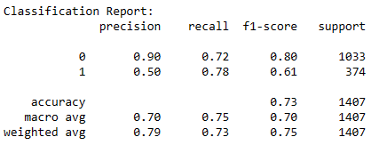
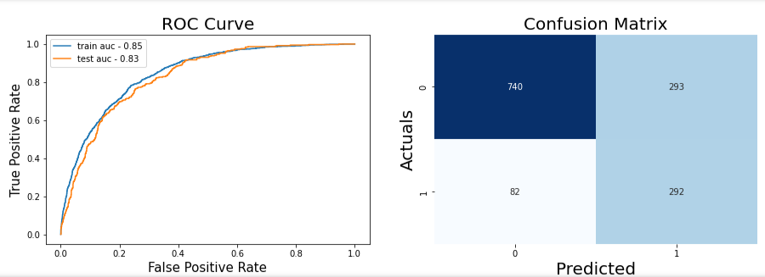
Logistic Regression

Slide 19
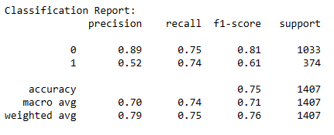
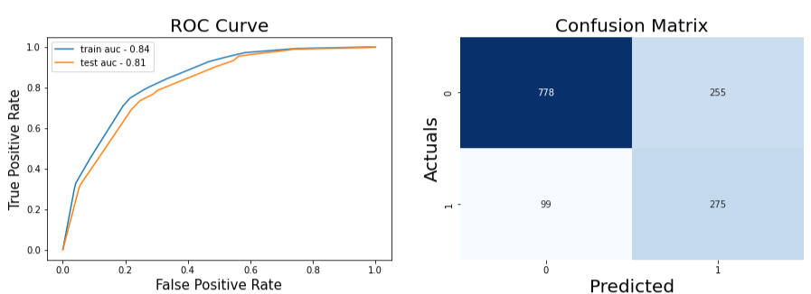
Decision Tree Classifier

Slide 20
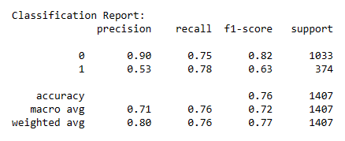
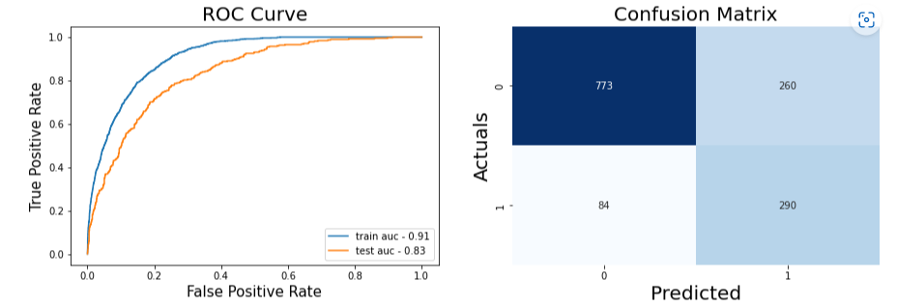
Random Forest Classifier

Slide 21
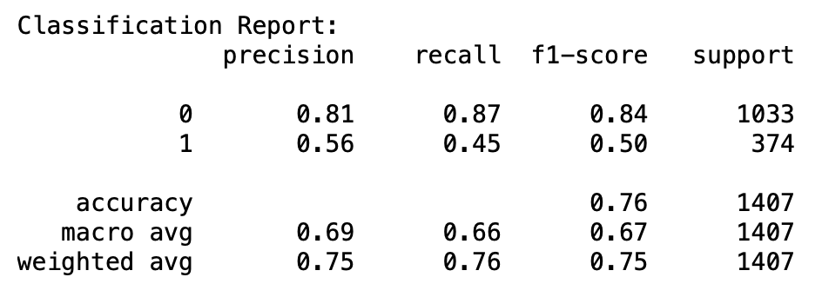
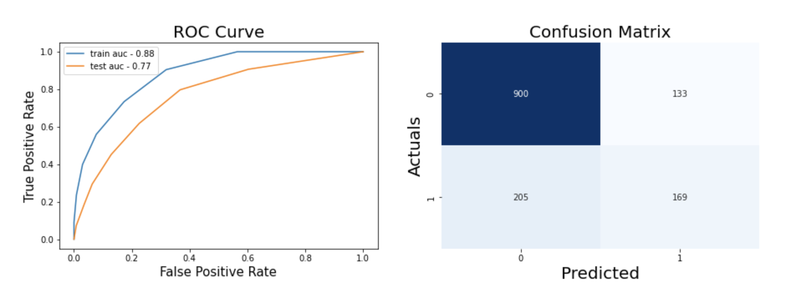
K-Nearest Neighbor

Slide 22
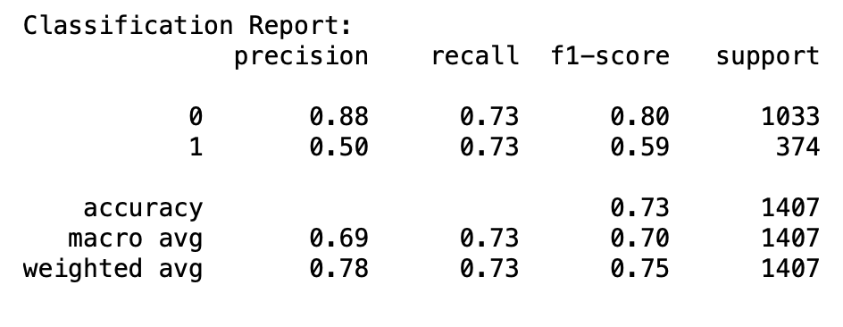

Gaussian Naive Bayes

Slide 23
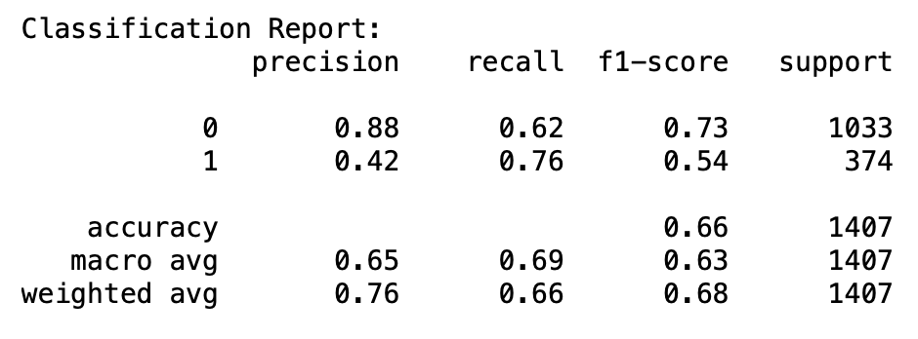
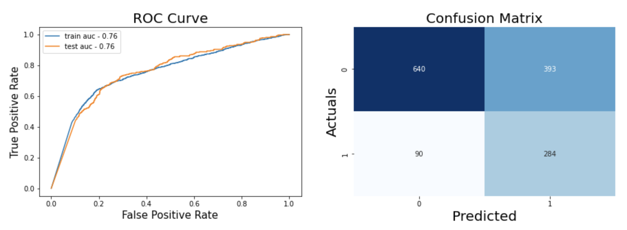
Multinomial Naive bayes

Slide 24
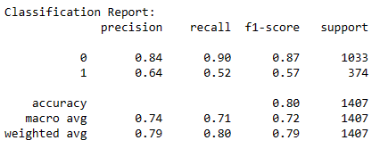
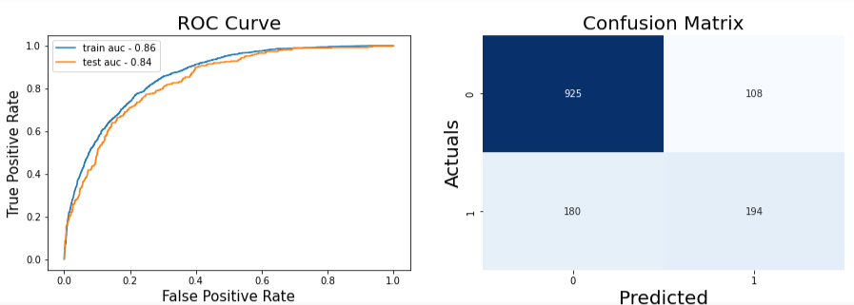
Ada Boost Classifier

Slide 25
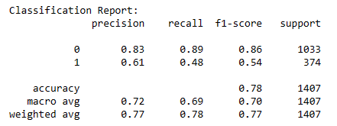
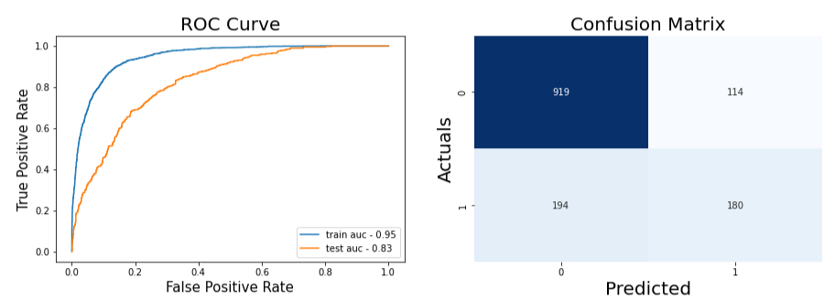
Gradient Boosting Classifier

Slide 26
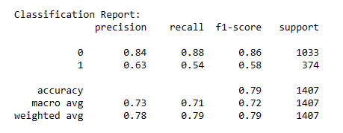
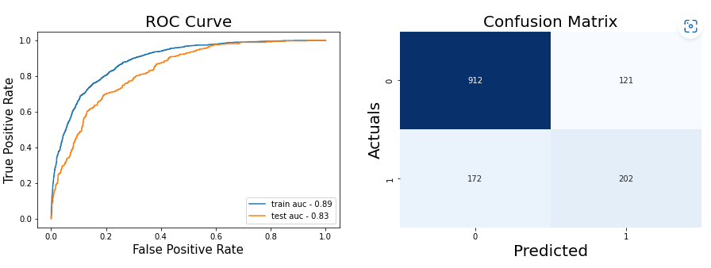
XG Boost

Slide 27
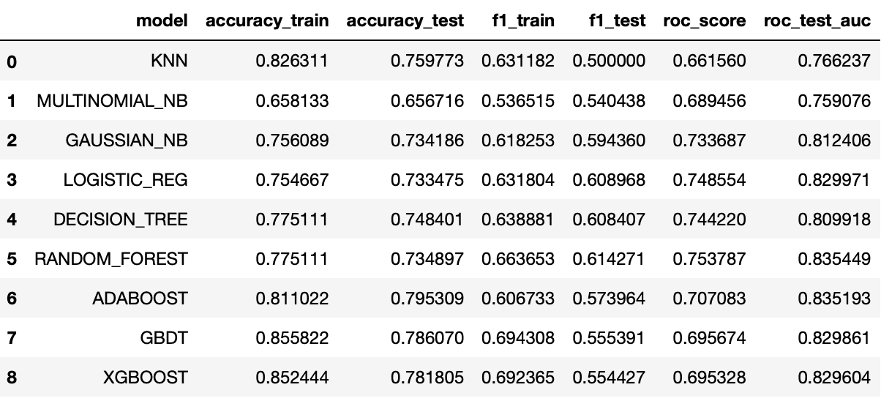
Model Comparison

Slide 28
References
[1] Kimura, T. (2022). Customer churn prediction with hybrid resampling and ensemble learning. Journal of Management Information and Decision Sciences, 25(1), 1-23
[2] Wang, Xing & Nguyen, Khang & Nguyen, Binh. (2020). Churn Prediction using Ensemble Learning. 56-60. 10.1145/3380688.3380710

Slide 29
Thank You!

